Slide 1
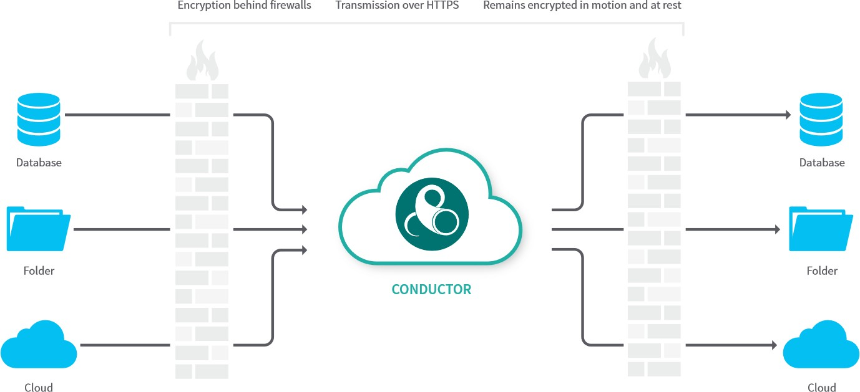
What is IDE?
ACC’s IDE = EightWire’s Data Exchange (DX) Platform
Manage data transfers and perform data transfers
Definitions
Data source, Jobs,
schedules, and auditing
Data Processing Service

Slide 2
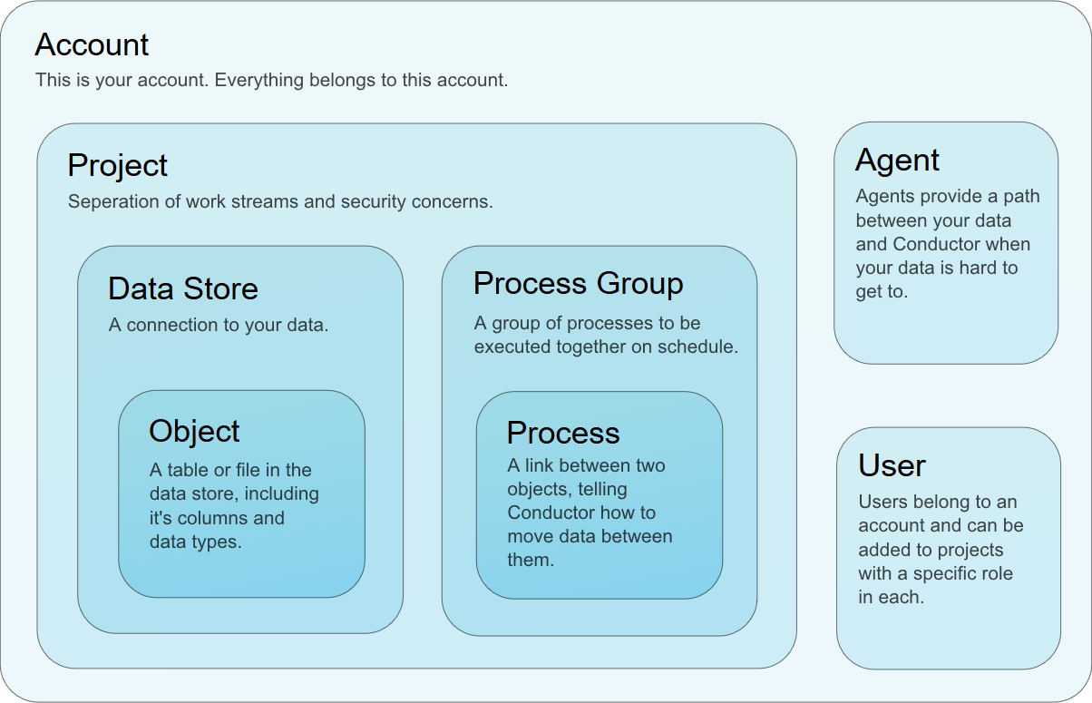
Conductor Basics
Eightwire's Conductor is off-the-shelf cloud-based data sharing software.
Conductor Entities

Slide 3
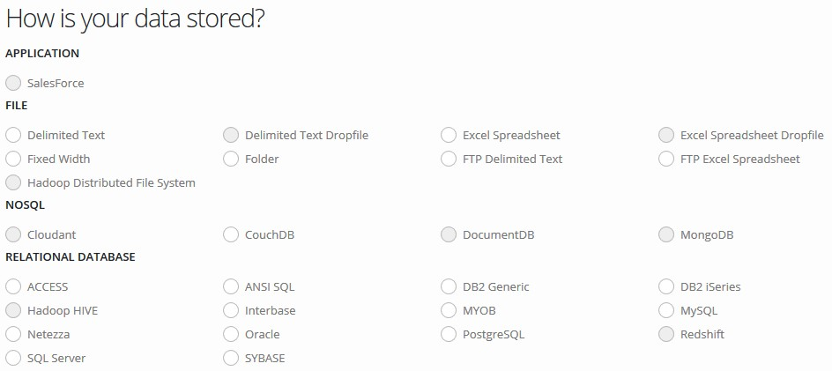
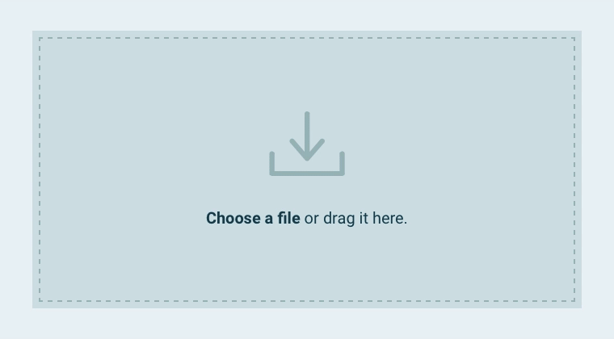
Connectors
The Eightwire Conductor platform is designed to read and write data to and from a wide variety of different data platforms, from files to databases.
Drag N Drop
Each Connector is required to perform the same basic tasks but they accomplish those tasks in quite different ways. For example, when asked to write data, an Excel Spreadsheet Connector will create an Excel file containing the data and store it in a folder system, whereas an SQL Server Connector will execute database commands to write the same data into the database.

Slide 4
New Words
Description | Definition
Eightwire | The platform that is used to transfer data
Responsible | The role that ensures the necessary activities for a particular task gets done.
Eightwire Agent | A small piece of software that is installed on a Windows machine at an organisation that make secure HTTPS web service calls to the Eightwire services.
MOU | Memorandum of Understanding covering the exchange of data between two organisations.
Agent server or Agent hosting server | The terms used to refer to the Windows machine (physical or virtual) that hosts the Agent.
Data staging point or Data staging area | The terms used to refer to the location that data is presented to the Agent and written to the Agent.
Data preparation | The term used to refer to the components and processes that deliver prepared data to the data staging point.
Data consumption | The term used to refer to the components and processes that copy data from the data staging point to elsewhere in an organisation.
Data Exchange, DX or IDE | Usually refers to a specific industry sector use-case, community or network of Eightwire Conductor customers, united under a common purpose, such as a government sector. Conductor is frequently referred to as The Data Exchange in some security and risk documentation and in New Zealand government-related documentation. ACC uses the term IDE for DX.
Eightwire's Conductor | The proper name of the Eightwire data platform. It is also referred to as data exchange, orchestrator, and Eightwire.
Portal, Web Portal | The web application used to manage Conductor Projects, Data Stores, Processes, etc. The web portal is part of Conductor's Master Services. Users do not need to remain logged in when running data transfers – once started data transfers (Batches) will continue even if the user logs out or closes their web browser.
Portal, Web Portal
The subject of this User Guide. The web application used to manage Conductor Projects, Data Stores, Processes, etc. The web portal is part of Conductor's Master Services. Users do not need to remain logged in when running data transfers – once started data transfers (Batches) will continue even if the user logs out or closes their web browser.

Slide 5
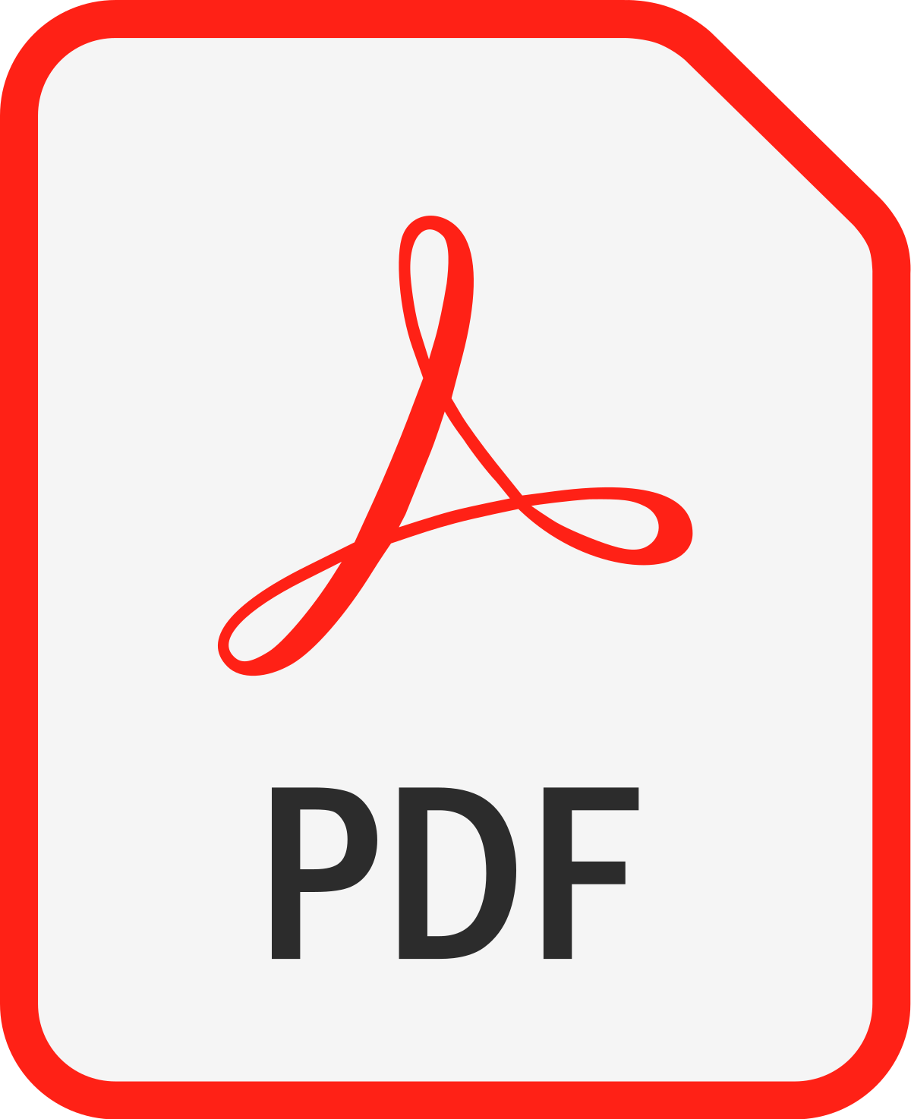
Privacy and Security Considerations
The Privacy Act 1993 sets out conditions which apply to the collection of personal information. Organisations understand their obligations and the conditions they need to meet to share data on the Data Exchange
Data Exchange certified by MSD to transfer data classified up to and including to SENSITIVE
All transferred data is encrypted between Data Exchange Agents. Uses SSL (TLSv1.2).
Encryption used in transit and on disk are different schemes
Mutual authentication between on-prem Agent and Data Exchange
The Cloud services are in 2 locations: Management Service is responsible for managing data source definitions, job definitions, schedules, and auditing. This is hosted by Microsoft Azure in Australia. No data is transferred via this service. The Data Processing Service transfers data between Agents and is managed by the Management Service. This is hosted by Revera in New Zealand. Data is transferred only via this service.
Organisation transferring data using the Data Exchange always retains full control of the data and systems in their organisation.
DX transfers just contents in files and databases
Subsets of data can be transferred by specifying filtering criteria when configuring data sharing on the Data Exchange.
Data can only be received by organisations connected to the Data Exchange that have been allowed to receive the data by the organisation sharing the data. Shared data is never available to “just anyone”.
Data is streamed from the data sharing organisation to the data receiving organisation via the Data Exchange. Once data arrives at the data receiving organisation it is no longer available on the Data Exchange.
All transferred data remains within New Zealand.
Checklist
Satisfied with the security robustness of the DDX for the type of data you are transferring.
Satisfied your own connectivity to the Data Exchange is suitably secure.
Resources
Security Certification details of the Data Exchange*
Privacy Impact Assessment (PIA) template*
Security Risk Assessment template (SRA)*
*(provided on request)

Slide 6
Key People & Change Management Considerations
Commercials
Implementation
Manage internal technology and business parties in implementing IDE
Escalation Point
IDE
On-Boarding
Understand your Use Cases
Commercial Arrangements
Training
Implementation/Operational Support
Your
Implementation
Contacts
EightWire Limited
Design:
Clearance to use of IDE for Organisation
Design of the Data Preparation, Staging and Network Connectivity solution
ACC IDE
On-Boarding External Party
Understanding ACC Data requirements
ACC Connectivity & Data Queries
Architects –
Infra, Security, Data and Solution
ACC’s IDE Team
Product Analyst
Support Analyst
New/Changed Tasks
Data Preparation and Staging:
Creates and submits the Discharge data file using the Casemix tool
Helps resolve data queries
ACC Service Specification
Data Specifications
Data Consumer
Business Process Participant
ACC
Business Team
Agent Software Install / Operational Support
Installs. Configures and Supports the Agent
Deals with connectivity issues
Agent updates
New Tasks
DX Product Administration/Support
Uses the DX Cloud Platform to create, configure and support the Data Store
Connectivity & Data Queries
Change Management
Commercials
New/Changed Roles, Process and Product Training
Operational Support
Administrators – DB, Windows, Network and Security

